Slide 1

Monthly Gold Price Data(Python Time Series Forecasting Model)
A Project by Debasmita Paul

Slide 2
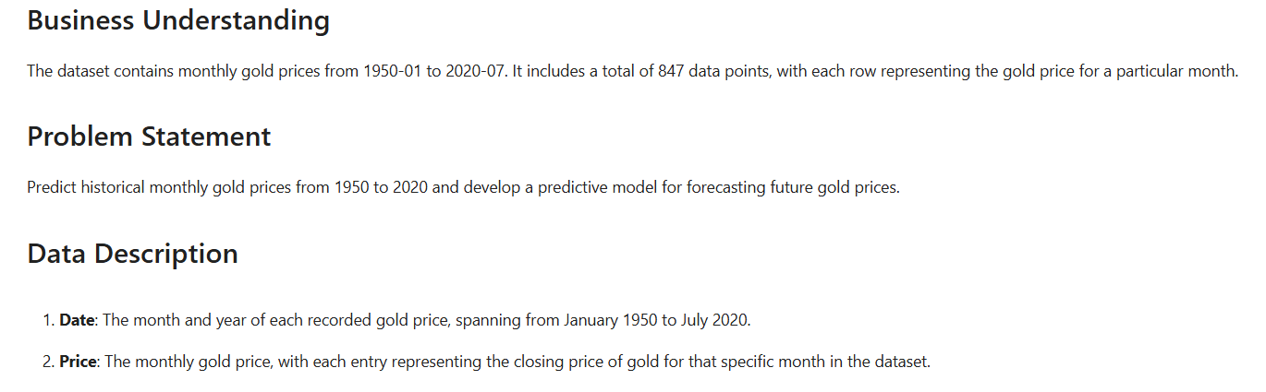
Gold Price Forecasting: Business Insight and Predictive Objective
The dataset comprises monthly gold prices from January 1950 to July 2020, totaling 847 entries, with each row representing a monthly gold price. The objective is to analyze historical trends and develop a predictive model for forecasting future gold prices.

Slide 3
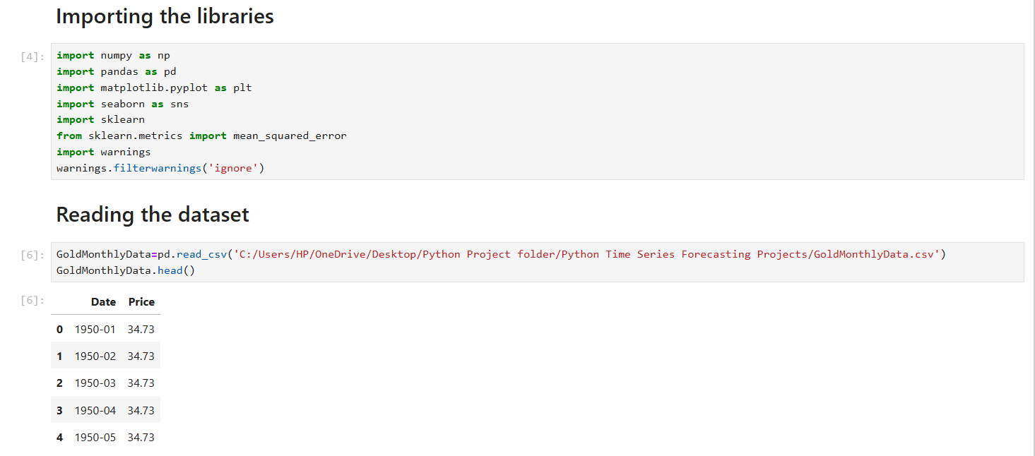
Libraries and Dataset Initialization
Libraries like NumPy, Pandas, Matplotlib, and Seaborn are imported for numerical operations, data handling, and visualizations, alongside sklearn for model evaluation with mean_squared_error. Warnings are suppressed to keep outputs clean. The dataset, containing monthly gold prices, is then loaded from a CSV file, and the first few rows are displayed for a quick review of its structure and contents.

Slide 4
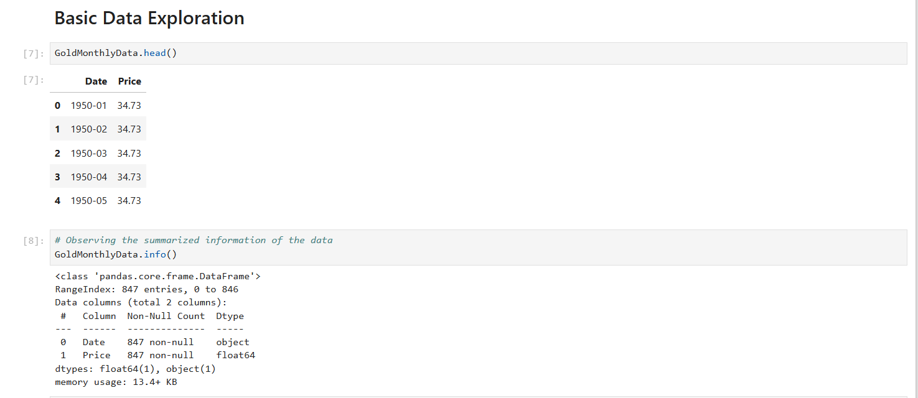
Initial Data Exploration
The dataset's structure and first few rows are examined to understand its content, followed by a summary of data types, non-null counts, and memory usage using .info() for a comprehensive overview.

Slide 5
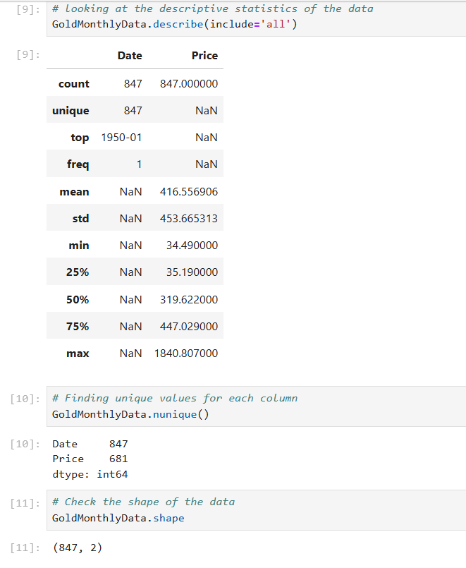
Comprehensive Data Summary
Descriptive statistics, unique value counts, and the dataset's dimensions are reviewed to assess data distribution, uniqueness, and overall shape, providing insights into the dataset’s structure and variability.

Slide 6
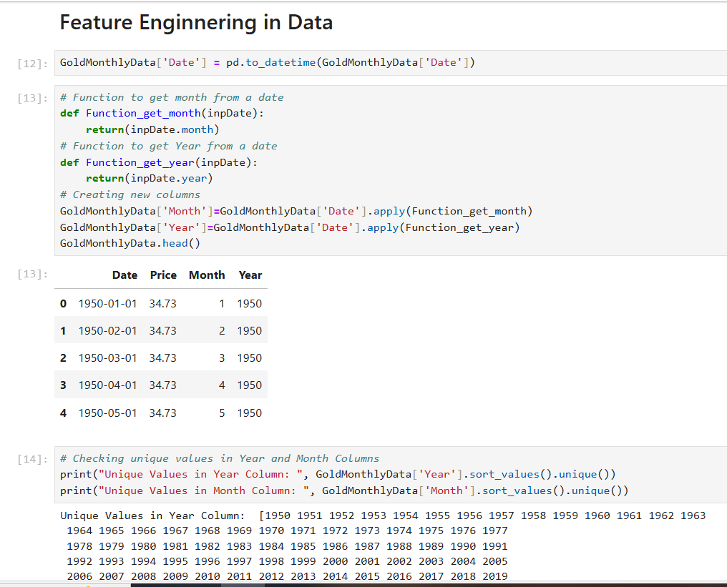
Date Feature Engineering and Analysis
The Date column is transformed into datetime format, and new Month and Year columns are created to support seasonal analysis. Unique values in these columns confirm a comprehensive range from 1950 to 2020, with all months represented for consistent trend evaluation.

Slide 7
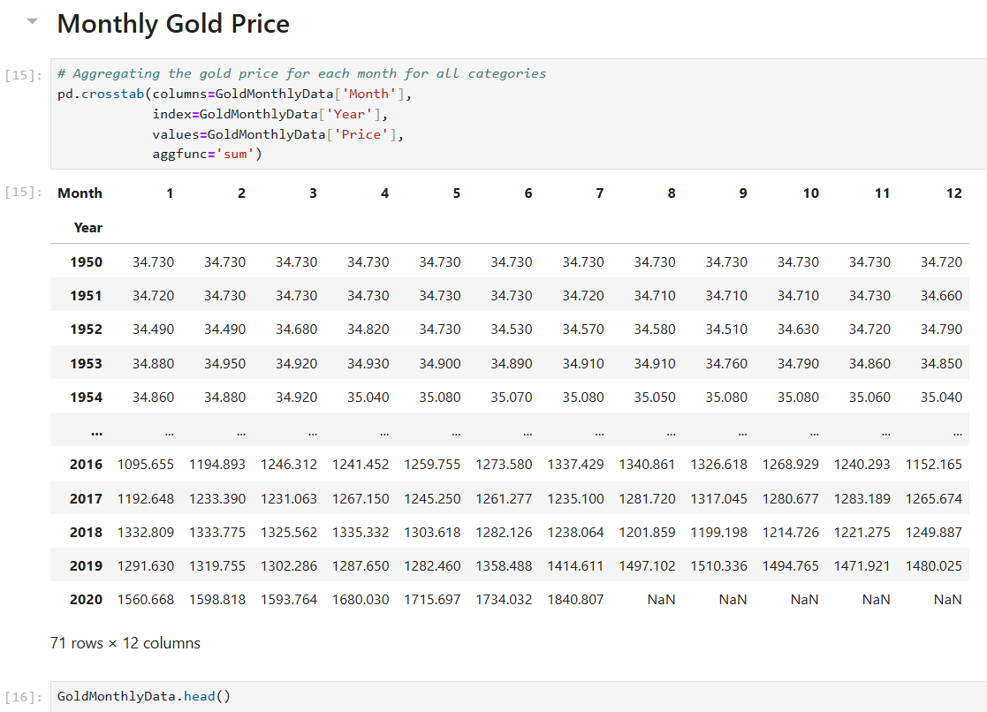
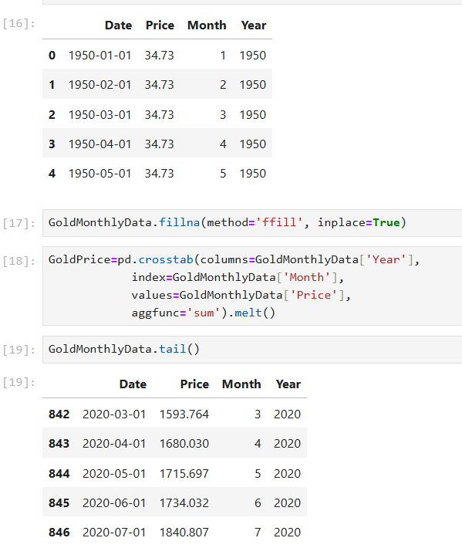
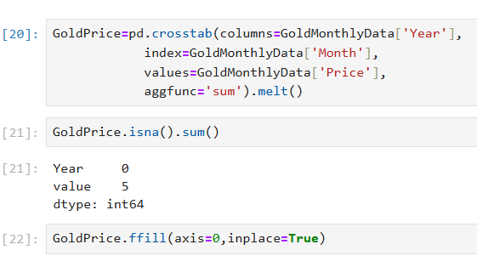
Monthly Gold Price Aggregation and Imputation
Gold prices are aggregated monthly across years to analyze yearly trends, and any missing values are forward-filled to ensure continuity. This prepares the dataset for comprehensive forecasting by handling gaps and reshaping the data for time series modeling.

Slide 8
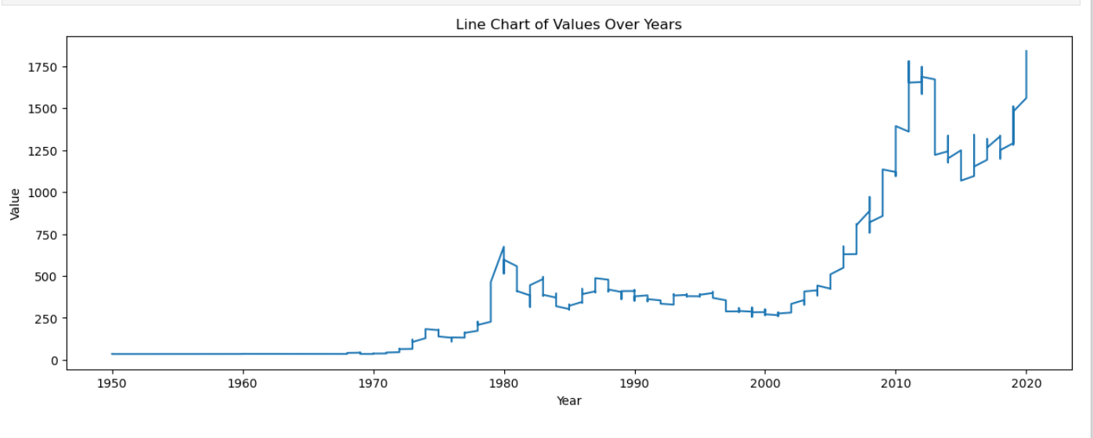
Yearly Gold Price Analysis: Patterns and Trends
A line chart is created to illustrate the trends of gold prices over the years, providing a clear visual representation of historical price fluctuations. With well-defined labels and titles, this chart facilitates the identification of long-term patterns and trends in gold pricing. This visualization serves as a valuable tool for understanding how gold prices have evolved over time..

Slide 9
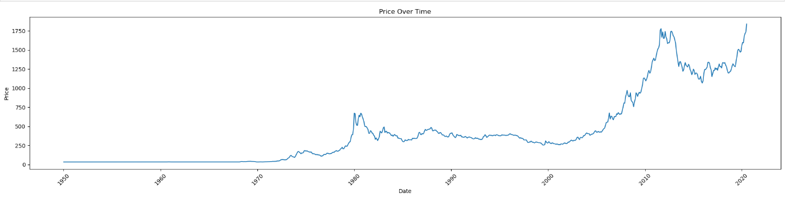
Visualizing Gold Prices: Trends Over Time
A time-series line chart effectively presents the monthly gold prices over time, utilizing a newly formatted date column for enhanced clarity. This visualization highlights fluctuations and trends in gold prices, allowing for a comprehensive understanding of their movement throughout the selected period. The engaging format aids in identifying significant changes and patterns in pricing behavior.

Slide 10
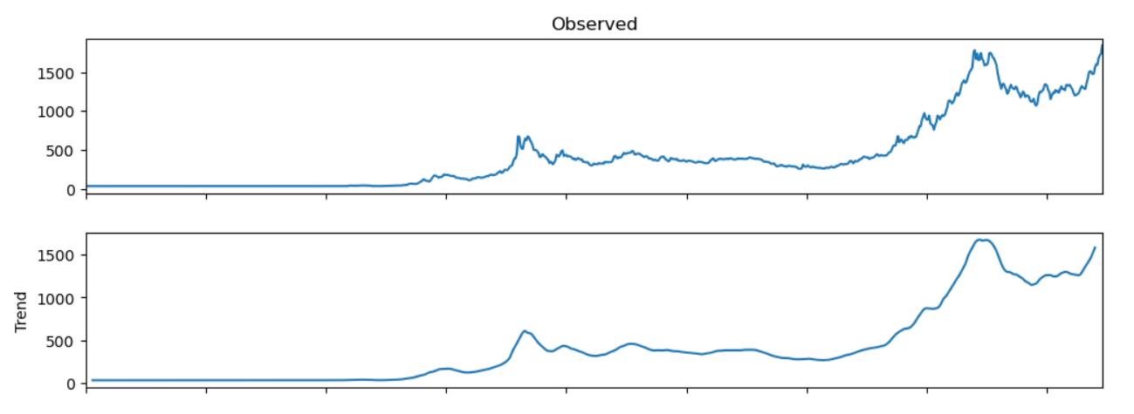
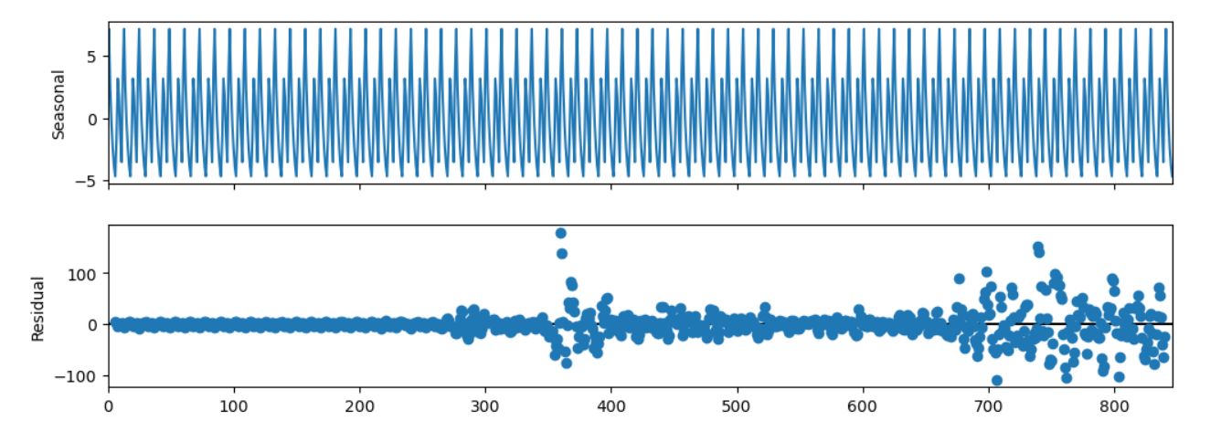
Seasonal Insights: Decomposing Gold Price Trends
The seasonal decomposition separates the gold price time series into its constituent components: trend, seasonal, and residual. The resulting plot provides a visual representation of these components, allowing for a clearer understanding of underlying patterns and variations in gold prices over time.

Slide 11
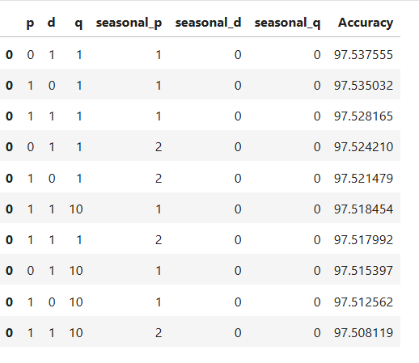
SARIMA Model Hyperparameter Optimization Process
The table displays various combinations of hyperparameters for the SARIMA model, including values for p, d, q, and their seasonal counterparts, along with the corresponding model accuracy. Each row represents a unique set of parameters tested, with the highest accuracy of approximately 97.54% achieved with the configuration p=0, d=1,q=1, seasonal_p=1,seasonal_d=0 and seasonal_q=0

Slide 12
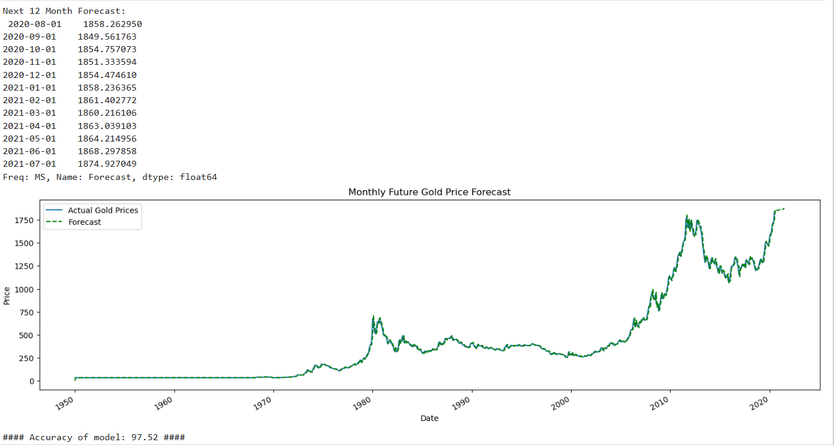
Forecasting Future Gold Prices: A SARIMA Approach
A SARIMA model is trained on historical gold price data to generate forecasts for the next 12 months, with results visually compared against actual prices. The model achieves an accuracy of approximately 97.52%, indicating a strong predictive performance for future gold price trends.

Slide 13
THANK YOU

